Slide 1
Besties Gadget Marketing.com

Slide 2
TODAYS Presenters
Order of Presentation:
Home Page & Thank you Page (by ALI abbas 23f-3037)
Watch & Add to cart & BGMM (BY Muhammad bilal )
Mobile & Laptop & Feedback (BY Minahil 23f-3036)

Slide 3

Home Page
Title.
Sub-title.

Slide 4
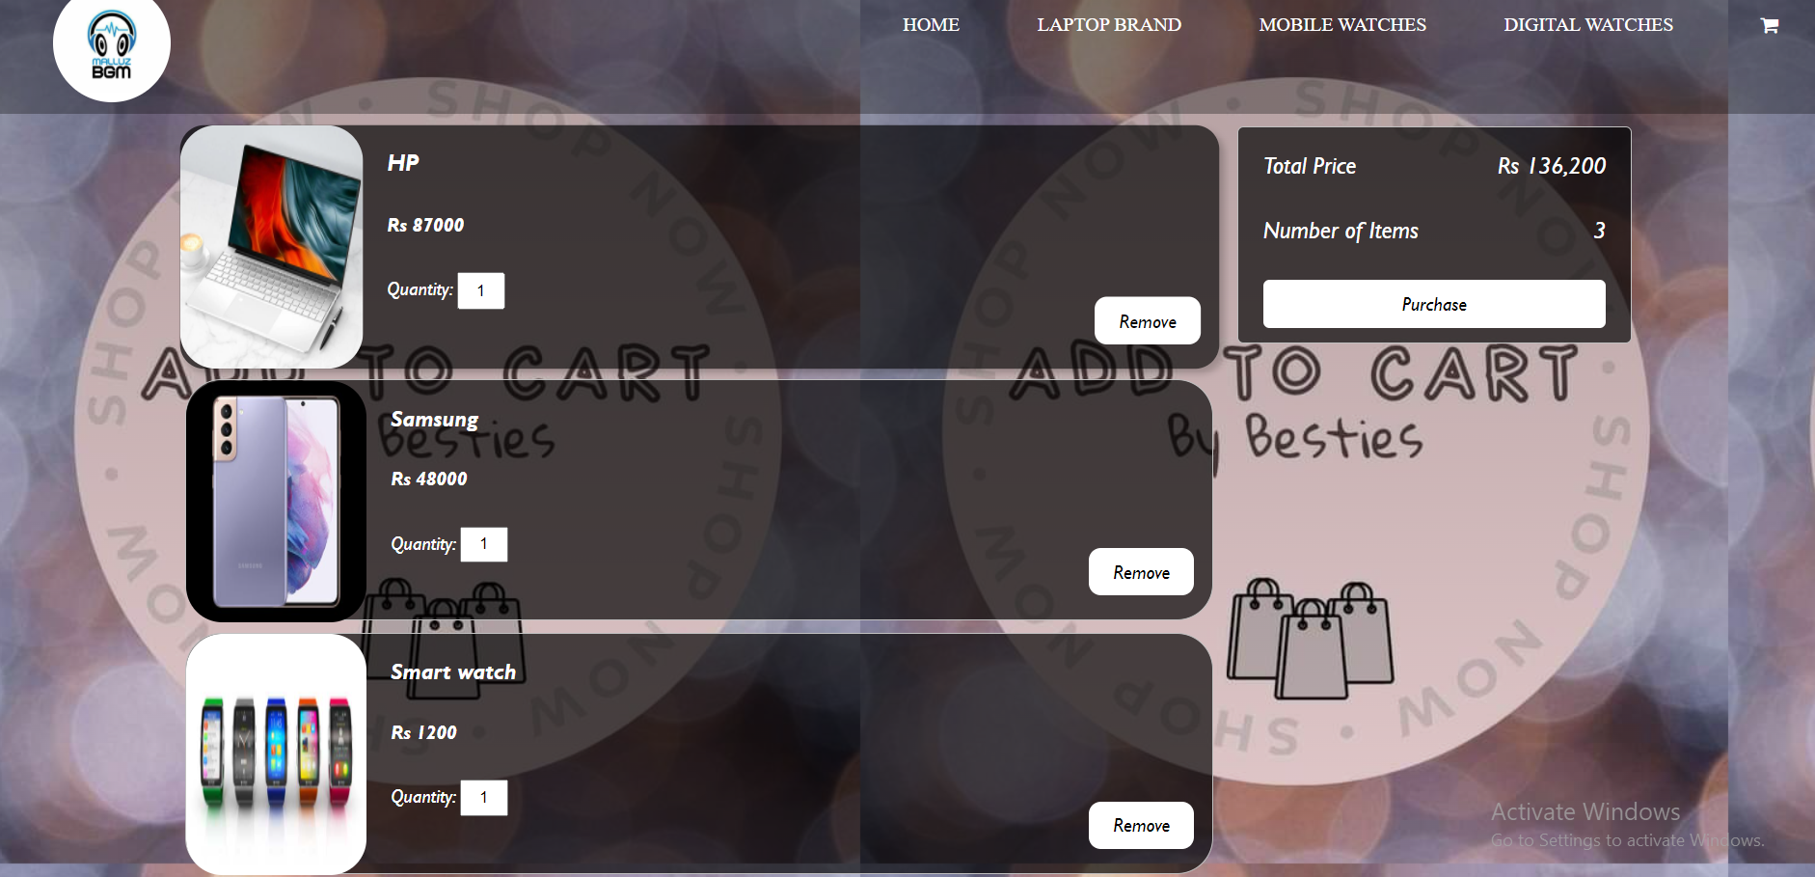
Add to Cart
Tabs of Products.
Total Cost Tab.
Button.

Slide 5
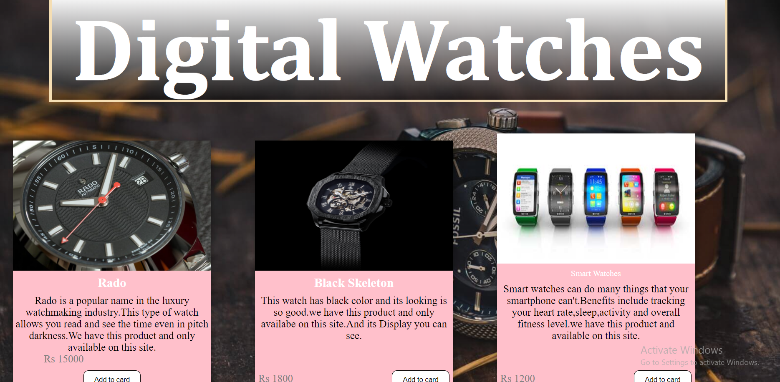
Digital Watches:
Add to Cart Button.
Customization of Button

Slide 6
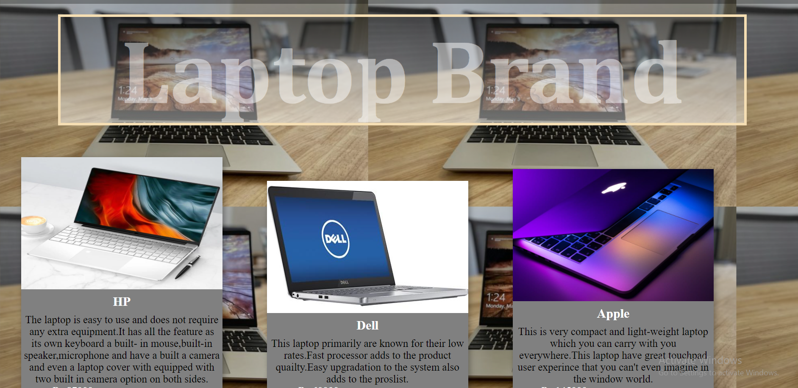
Laptop Brand
Heading.
Cards.

Slide 7
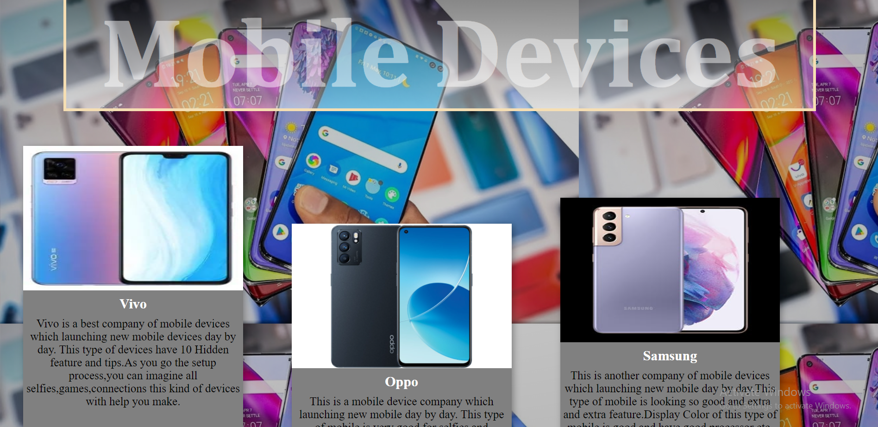
Mobile Devices
Image Customization.
Description Design.

Slide 8

Feedback Message
Colors.
Customizes Text.
Button.

Slide 9






Thank You Page

Slide 10
THANK YOU!
FOR YOUR TIME!

